Slide 1

Gokaraju Rangaraju Institute of Engineering and Technology (Autonomous) Department of Artificial Intelligence and Machine Learning Engineering
Deepfake Audio Detection using Deep Learning model
Presented by:
1. Harshitha Chilupuri (21241A6619)
2. Annapurna Nomula (21241A6650)
3. Akanksha Sangem (21241A6657)
Under the Guidance of:
Ms. A. Madhavi,
Assistant Professor,
Department of CSE (AI & ML)

Slide 2
Abstract
Deep fake audio is a threat to security and raises ethical concerns; hence, detection becomes a challenging task. This work helps to develop a deep learning-based method for the detection of deep fake audio. We are going to develop a technique to detect deep fake audio using a deep learning-based approach. The model will incorporate convolutional neural network (CNN) and LSTM (Long Short-Term Memory) layers to capture spatial and temporal features of audio. MFCCs(Mel-frequency Cepstral Coefficient) and spectrograms will be applied to the model using a dataset of real and synthesized audio. Experiments demonstrate that our model reaches high accuracy and robustness, outperforming baseline models. The approach effectively distinguishes real audio from deep fakes with a low false positive rate. The model exhibits strong resilience against state-of-the-art audio synthesis techniques, making it a promising solution for automated audio verification systems. Future work will enhance model performance through adversarial training and dataset expansion.

Slide 3
Objectives
Audio Features: To use MFCCs and spectrograms for distinguishing real and fake audio
Accuracy Testing on Real and Fake Audio: To test model accuracy on real and fake audio clips.
Enhancing Model Robustness: To enhance robustness by adding data and new techniques.
Minimizing False Positives : To minimize false positives by reducing real-audio misclassifications.

Slide 4
Existing Approaches (Literature Survey)
Ref. No. | Methodology | Dataset Name | Advantage | Drawbacks | Results
1. | Audio Language Models(ALMs), including codec-trained models, along with feature extraction techniques like Wav2Vec, and detection models. | A large-scale speaker identification dataset called ‘VoxCeleb’, that can be useful for training and evaluating detection models like LCNN. | Utilizing ALMs, codec-trained models, and advanced detection techniques by improving the performance of deep fake audio detection systems. | Traditional models struggled with the sophistication of ALM-based audio, codec-trained countermeasures offer a promising approach for effectively detecting these types of deepfakes. | Codec-trained model achieved 0% EER; W2V2-AASIST reached 9.424% EER (approx. 90.576%).
2. | This project combined the Codecfake dataset with co-training stratergies, notable CSAM, to enhance detection of ALM-based audio deepfakes. | A dataset that is specifically designed for the detection of deep fake audio, containing a wide range of synthesized audio samples. | The combination of high-quality datasets with co-training strategies allows for more effective training cycles, improving convergence rates and reducing the time required for training the models | This project has various limitations like Generalization Challenges, such as: i. Source Training, ii. Narrow Audio Types, iii. Acoustic Conditions | An EER of 0.616 % with the W2V2-AASIST (CSAM) model has been recorded, indicating a low error rate. (approx 99.384%)

Slide 5
Existing Approaches (Literature Survey)
Ref. No. | Methodology | Dataset Name | Advantage | Drawbacks | Results
3. | The project used an Attack Agnostic dataset and a Linear Convolutional Network (LCNN) with LFCC(Linear Frequency Cepstral Coefficients) and mel-spectrogram front-ends for audio DeepFake detection. | A dataset that is designed to evaluate audio deepfake detection models in a manner that is not influenced by specific attack methods. | The LCNN architecture is flexible and can be adapted to different audio processing tasks, making it suitable for deepfake detection and audio classification tasks. | The project has a serious lack of potential diversity in datasets regarding ethnicity, age, as well as the challenge of generalization and stability across various audio datasets remained same | The paper has reported an EER (Equal error Rate) of 2.37% for the best model LCNN across different datasets folds
4. | The project has proposed the BTS-E(Breathing-Talking SilenceEvaluation)framework, which evaluates the correlation between breathing, talking, and the silence sounds within the audio clips to detect deepfake voices. | A custom dataset designed to include various audio samples with distinct features related to breathing, talking, and silence is used. (LibriSpeech) | The framework's ability to analyze various sound components (breathing, talking, and silence) allows for a more comprehensive evaluation of audio clips. | A complexity of accurately capturing natural breathing sounds across diverse voice to generalize effectively. | The project has improved the classifier performance by up to 46% compared to the previous models.

Slide 6
Existing Approaches (Literature Survey)
Ref. No. | Methodology | Dataset Name | Advantage | Drawbacks | Results
5. | Analyzed various deepfake detection techniques, including machine learning and deep learning approaches. | A Custom Dataset of user’s voices | Most simplest and easiest approach of detecting a deepfake audio. | Real-Time detection and Generalization across datasets. | Achieved an accuracy of over 90% on specific datasets.
6. | Utilized signal processing techniques and machine learning algorithms to create a real-time system for detecting AI-generated speech. | A custom dataset of AI-generated voices and user voices. | Works well with diverse datasets. | Variability in voice quality and accents that could affect accuracy. | The accuracy of the detection system would depend on various factors, including the quality of the training data, the algorithms used.

Slide 7
Existing Approaches (Literature Survey)
Ref. No. | Methodology | Dataset Name | Advantage | Drawbacks | Results
7. | It employs t-testing to statistically analyze temporal audio features and optimizes 208 machine learning models through 10-fold cross-validation. The best-performing model, Extreme Gradient Boosting (XGBoost) | A custom dataset generated for this study, containing real human speech from eight well-known figures via Retrieval-based Voice Conversion. | The model is capable of real-time speech classification with a processing time of 0.004 milliseconds per second of speech | The dataset contains speech from only eight figures, which may limit the generalization of the model to voices outside of the dataset. | 99.3% accuracy achieved with the Extreme Gradient Boosting (XGBoost) model
8. | MFCCs(Mel-frequency cepstral coefficients) technique is used to acquire information from the audio. | Fake-Or-Real (FoR) Dataset, created with a text-to-speech model and is divided into sub-sections. | The VGG-16 model outperforms other state-of-the-art approaches. | Potential fluctuation and distortion in the audio signals. | SVM model outperformed the other Machine Learning models in terms of accuracy for the dataset.

Slide 8
Existing Approaches (Literature Survey)
Ref. No. | Methodology | Dataset Name | Advantage | Drawbacks | Results
9. | A self-supervised pre-trained model (HuBERT) to improve detection in the audio. | A custom dataset consisting of Fake and Real audio. | Slightly improved when the languages of the pre-trained database, and the fine-tuned database are same. | Insufficient data generalization and insufficient feature extraction for unknown voice. | An equal-error rate (EER) of 2.89% has been achieved.
10. | Deepfake-Detection techniques using Deep Learning based algorithms like CNNs. | Celeb-DF and Audio DeepFake Dataset | Usage of CNNs enabled higher accuracy of deep fake audio detection. | Can not focus on features like temporal and spectral audio patterns. | Graded with 80% accuracy with the specified methodology.

Slide 9
Existing Approaches (Literature Survey)
Ref. No. | Methodology | Dataset Name | Advantage | Drawbacks | Results
11. | AdaBoost has been utilized to improve the efficiency of the audio detection. | A custom-generated dataset of real and cloned audio samples from 49 adult participants | Biological Insights and Diverse Datasets. | Limited Sample Size | AdaBoost achieved the highest performance with a 5-fold cross-validation balanced accuracy of 81%.
12. | Extreme Gradient Boosting (XGBoost) model has been used. | Deep-Voice dataset using Retrieval-based Voice Conversion. | Can detect a variety of accents for deepfake audio detection. | Limited Feature specificity | An overall test accuracy of 79% on unseen data.

Slide 10
Existing Approaches (Literature Survey)
Ref. No. | Methodology | Dataset Name | Advantage | Drawbacks | Results
13. | XAI models (LIME, SHAP, GradCAM) and the deepfake audio detection process, helping to identify key frequency bands for classification. | FoR (Fake-or-Real) dataset with diverse range | Quality Assessment and Diverse Dataset | Data Input Limitation | Graded with a FAD score 23.814 indicating fake-audio is of high-quality.
14. | A hybrid scheme for CNN and LSTM with MFCC | WaveFake and Release in the Wild | Feature-Rich Approach and Hybrid Model. | Dataset Limitations | Achieved a high accuracy of 94.73%

Slide 11
Existing Approaches (Literature Survey)
Ref. No. | Methodology | Dataset Name | Advantage | Drawbacks | Results
15. | The project uses ASVspoof-trained models (GBDT, AST, and Wav2Vec models) | FakeAVCeleb Dataset with equal number of spoof and actual audio samples. | 1.Improved Scoring Interpretability 2.High Accuracy with Small Datasets 3.Actionable Feedback | A significant gap in the model’s ability to provide human-understandable explanations. | Precision is 0.51,0.85 and 0.97 for GBDT, AST, and Wav2Vec models.

Slide 12
Software & Hardware Requirements
Minimum Software Requirements
Python 3.x
TensorFlow/Keras
Librosa
Minimum Hardware Requirements
RAM: It should have at least 8GB RAM
CPU: Intel Core i5 or higher

Slide 13
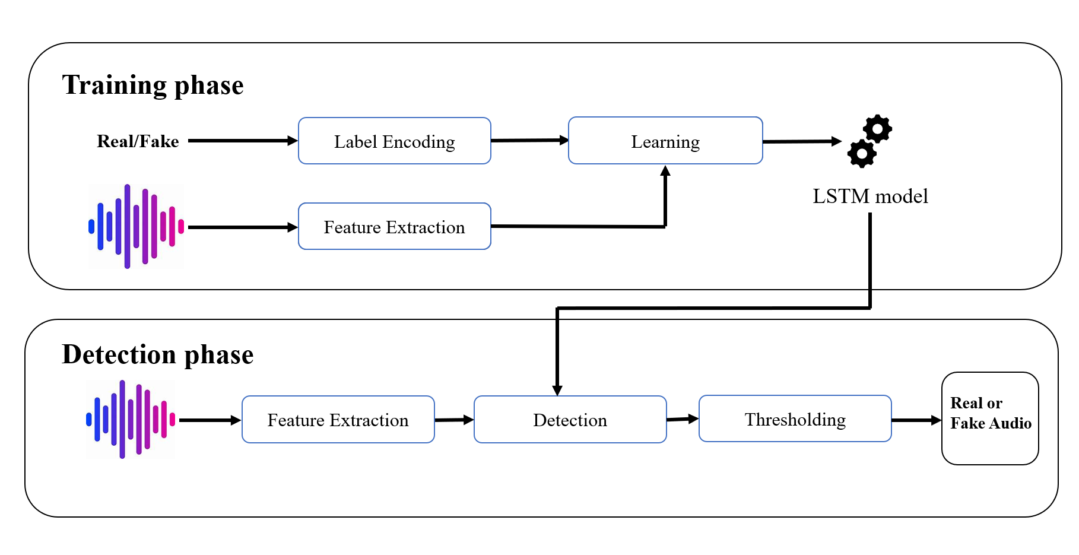
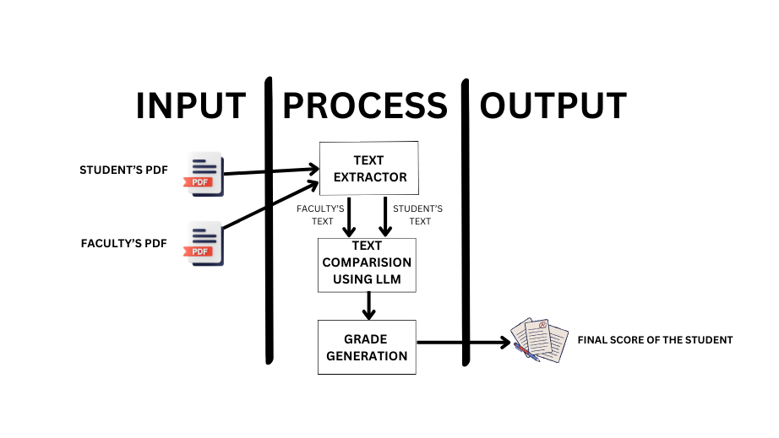
Proposed Method: Architecture Diagram

Slide 14

Proposed Method: Architecture Diagram
Pre-Processing
Feature Extraction

Slide 15
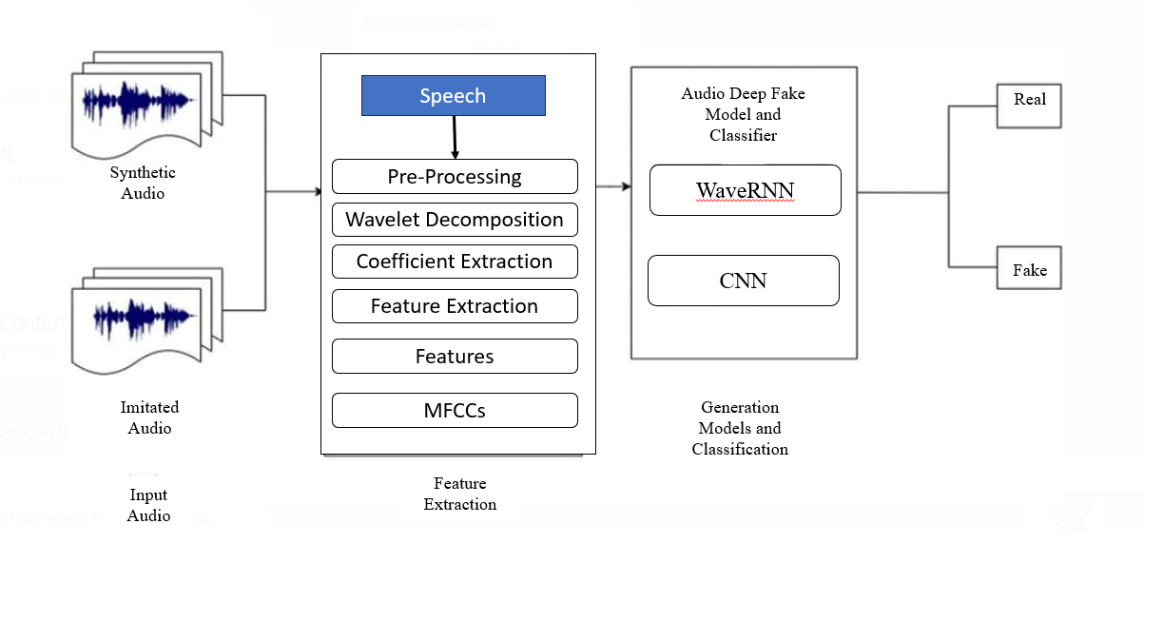
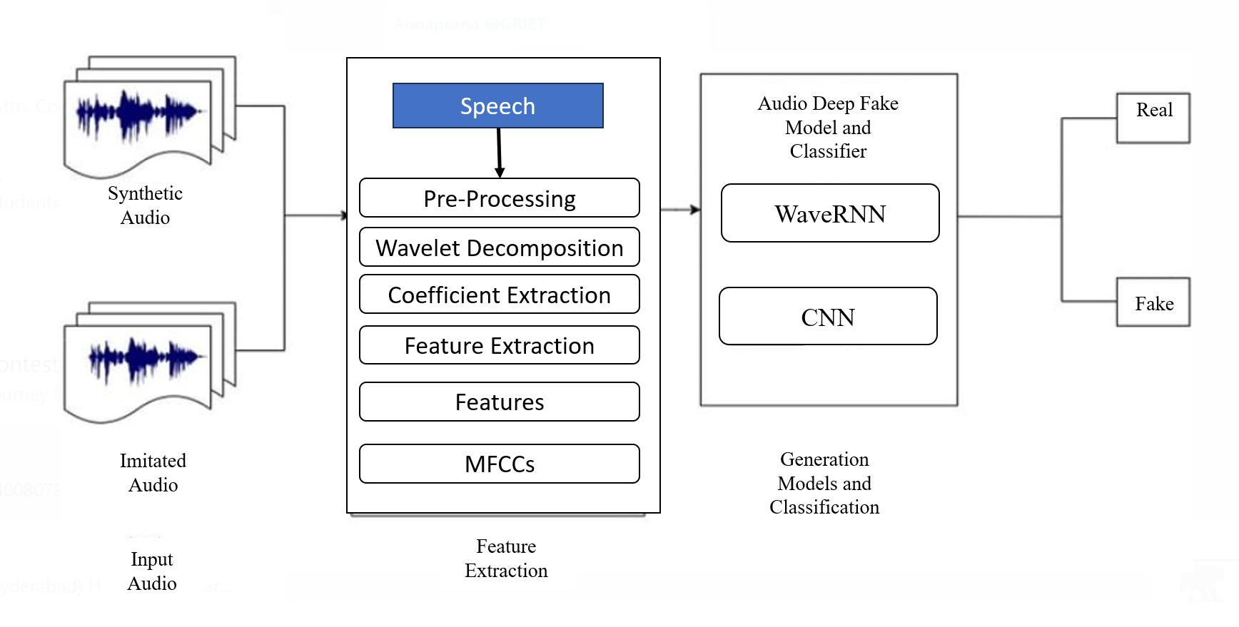
Proposed Method: Module Connectivity Diagram
Classification

Slide 16
References
[1] Xie Yuankun, Xiong Chenxu, Wang Xiaopeng, Wang Zhiyong, Lu Yi, Qi Xin , Fu Ruibo , Liu Yukun , Wen Zhengqi , Tao Jianhua , Li Guanjun , Ye Long. (2024). Does Current Deepfake Audio Detection Model Effectively Detect ALM-based Deepfake Audio?.
DOI: 10.48550/arXiv.2408.10853
[2] Xie, Yuankun & Lu, Yi & Fu, Ruibo & Wen, Zhengqi & Wang, Zhiyong & Tao, Jianhua & Qi, Xin & Wang, Xiaopeng & Liu, Yukun & Cheng, Haonan & Ye, Long & Sun, Yi. (2024). The Codecfake Dataset and Countermeasures for the Universally Detection of Deepfake Audio.
DOI: 10.48550/arXiv.2405.04880

Slide 17
References
[3] Kawa, Piotr & Plata, Marcin & Syga, Piotr. (2022). Attack Agnostic Dataset: Towards Generalization and Stabilization of Audio DeepFake Detection. 4023-4027.
DOI: 10.21437/Interspeech.2022-10078
[4] T. -P. Doan, L. Nguyen-Vu, S. Jung and K. Hong, "BTS-E: Audio Deepfake Detection Using Breathing-Talking-Silence Encoder," ICASSP 2023 - 2023 IEEE International Conference on Acoustics, Speech and Signal Processing (ICASSP), Rhodes Island, Greece, 2023, pp. 1-5.
Doi: 10.1109/ICASSP49357.2023.10095927.

Slide 18
References
[5] M. S. Rana, M. N. Nobi, B. Murali and A. H. Sung, "Deepfake Detection: A Systematic Literature Review," in IEEE Access, vol. 10, pp. 25494-25513, 2022
DOI: 10.1109/ACCESS.2022.3154404.
[6] Jordan J. Bird, Ahmad Lotfi (2023). Real-time Detection of AI-Generated Speech for DeepFake Voice Conversion.
DOI: https://doi.org/10.48550/arXiv.2308.12734

Slide 19
References
[7] Bird, Jordan & Lotfi, Ahmad. (2023). Real-time Detection of AI-Generated Speech for DeepFake Voice Conversion. DOI: 10.48550/arXiv.2308.12734.
[8] Cazarez, R. L. U., & Martin, C. L. (2018). Neural networks for predicting student performance in online education. IEEE Latin America Transactions, 16(7), 2053–2060.
https://doi.org/10.1109/TLA.2018.8447376

Slide 20
References
[9] Cook, C. R., Kilgus, S. P., & Burns, M. K. (2018). Advancing the science and practice of precision education to enhance student outcomes. Journal of School Psychology, 66(SI), 4–10.
https://doi.org/10.1016/j.jsp.2017.11.004
[10] Corbett, A. T., & Anderson, J. R. (1995). Knowledge tracing: Modeling the acquisition of procedural knowledge. User Modeling and User-Adapted Interaction, 4(4), 253–278.
https://doi.org/10.1007/BF01099821

Slide 21
References
[11] Fischer, C., Pardos, Z. A., Baker, R. S., Williams, J. J., Smyth, P., Yu, R., Slater, S., Baker, R., & Warschauer, M. (2020). Mining big data in education: Affordances and challenges. Review of Research in Education, 44(1), 130–160.
https://doi.org/10.3102/0091732X20903304
[12] Kulik, J. A., & Fletcher, J. D. (2016). Effectiveness of intelligent tutoring systems: A metaanalytic review. Review of Educational Research, 86(1), 42–78.
https://doi.org/10.3102/0034654315581420

Slide 22
References
[13] Su Youn Yoon (2023) Short answer grading using one-shot prompting and text similarity scoringmodel
https://doi.org/10.48550/arXiv.2305.18638
[14] M. S. Rana, M. N. Nobi, B. Murali and A. H. Sung, "Deepfake Detection: A Systematic Literature Review," in IEEE Access, vol. 10, pp. 25494-25513, 2022
DOI: 10.1109/ACCESS.2022.3154404.

Slide 23
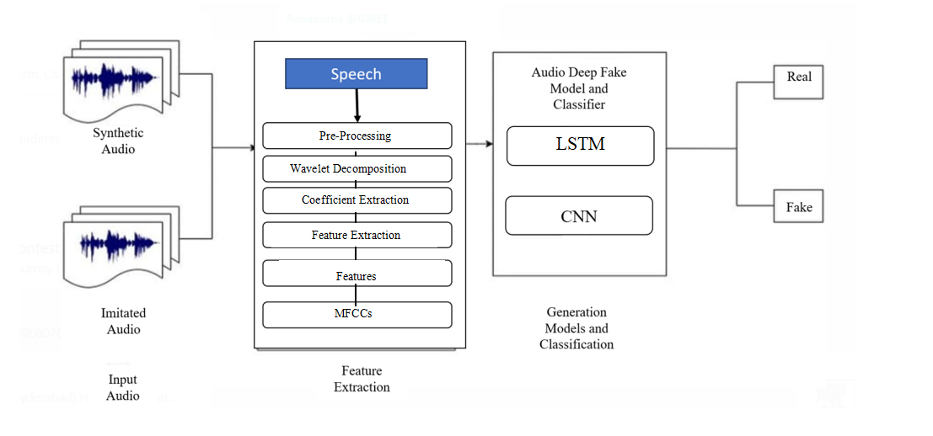
References
[15] Kawa, Piotr & Plata, Marcin & Syga, Piotr. (2022). Attack Agnostic Dataset: Towards Generalization and Stabilization of Audio DeepFake Detection. 4023-4027.
DOI: 10.21437/Interspeech.2022-10078

Slide 24
